Slide 1
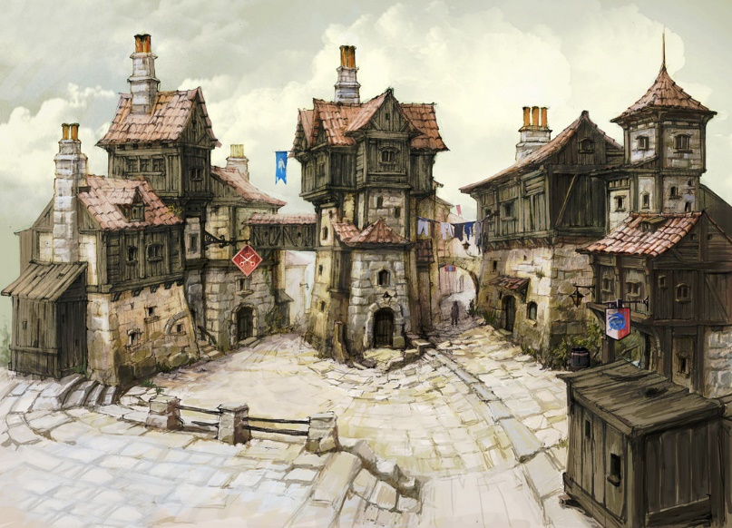
Kindling
Andrew Benson
Keiji Kimura
Orien Longo
Dennis Paramonov
Simon Yang

Slide 2
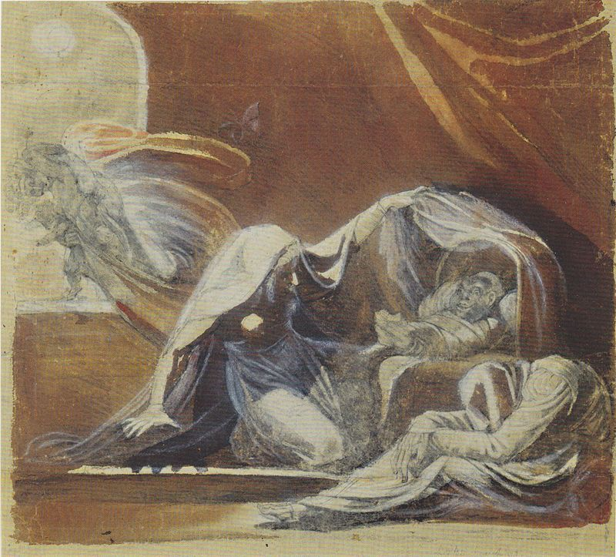

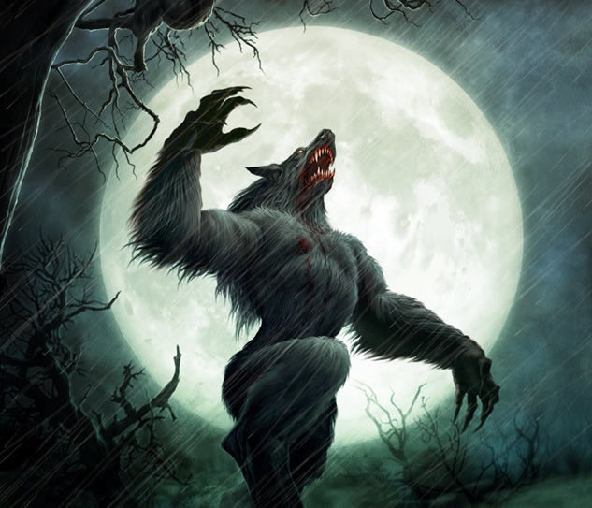
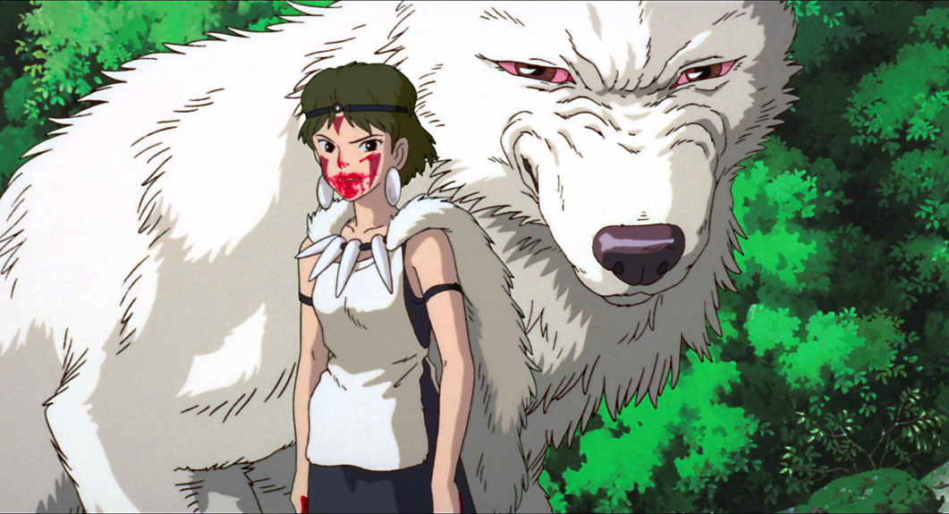
The ‘Other’

Slide 3
Type of experience
What will players do:
Exploration
Observing a crime scene
Mystery
Discovering a mythology
What happened here?
Play as a silent observer
What will players feel:
Suspense
Unease
Wonder
Horror

Slide 4
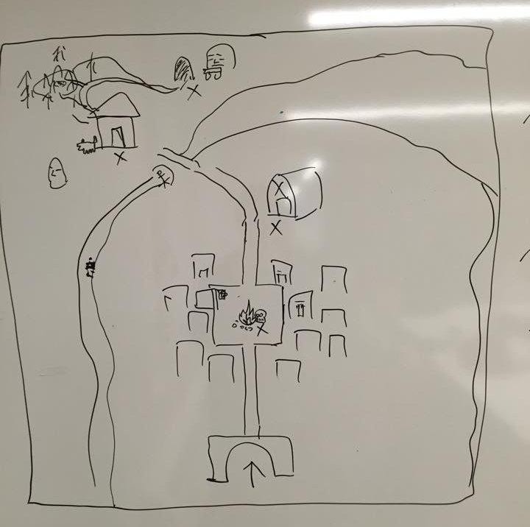
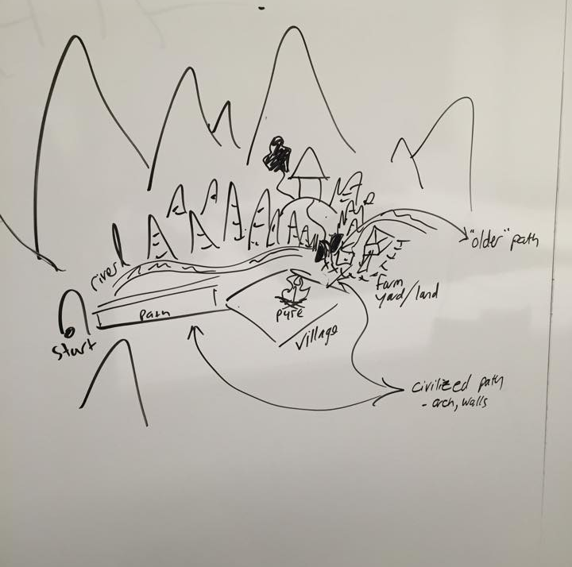
What happened here?
How will the player’s perceived understanding of the events change as they explore the various locations

Slide 5
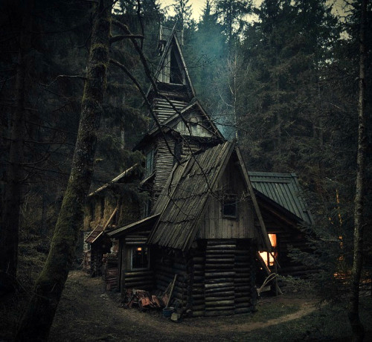
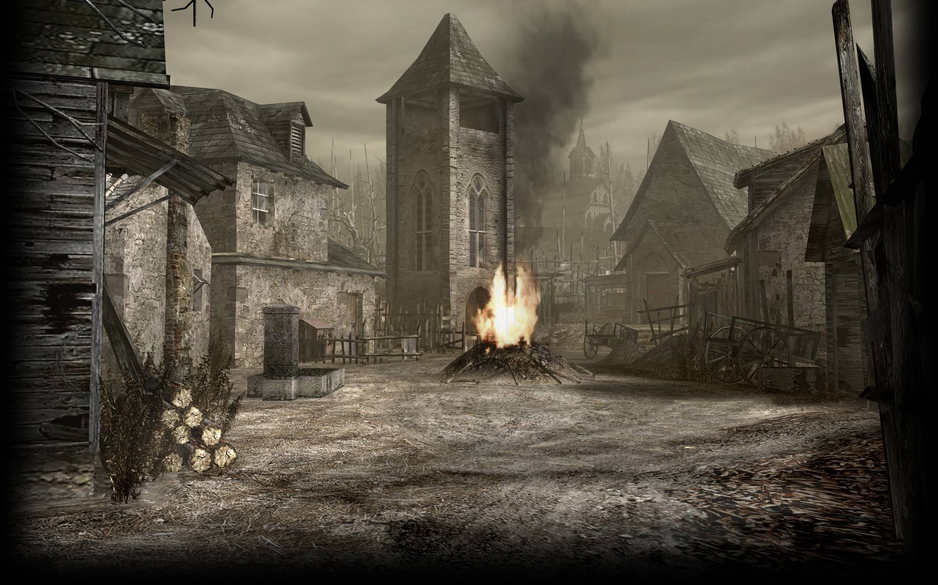
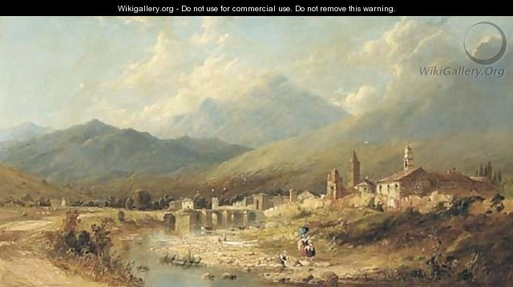
Setting

Slide 6
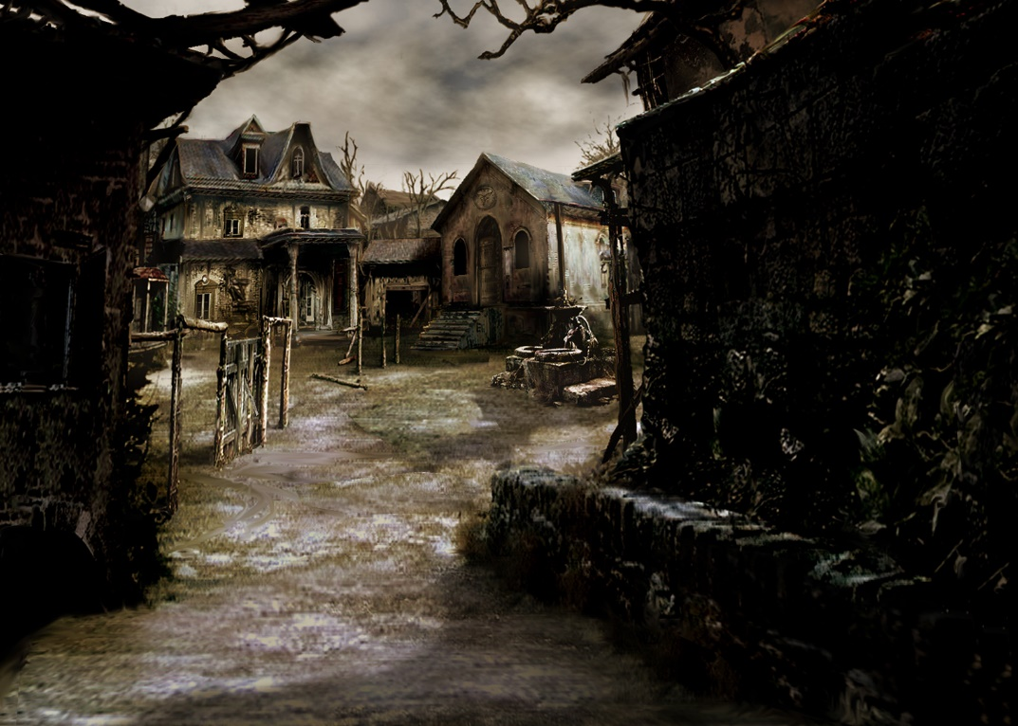



Slide 7

Our intentions
Expectations vs. Reality
Superstition vs. Rationality
Ignorance vs. Innocence

